Slide 1

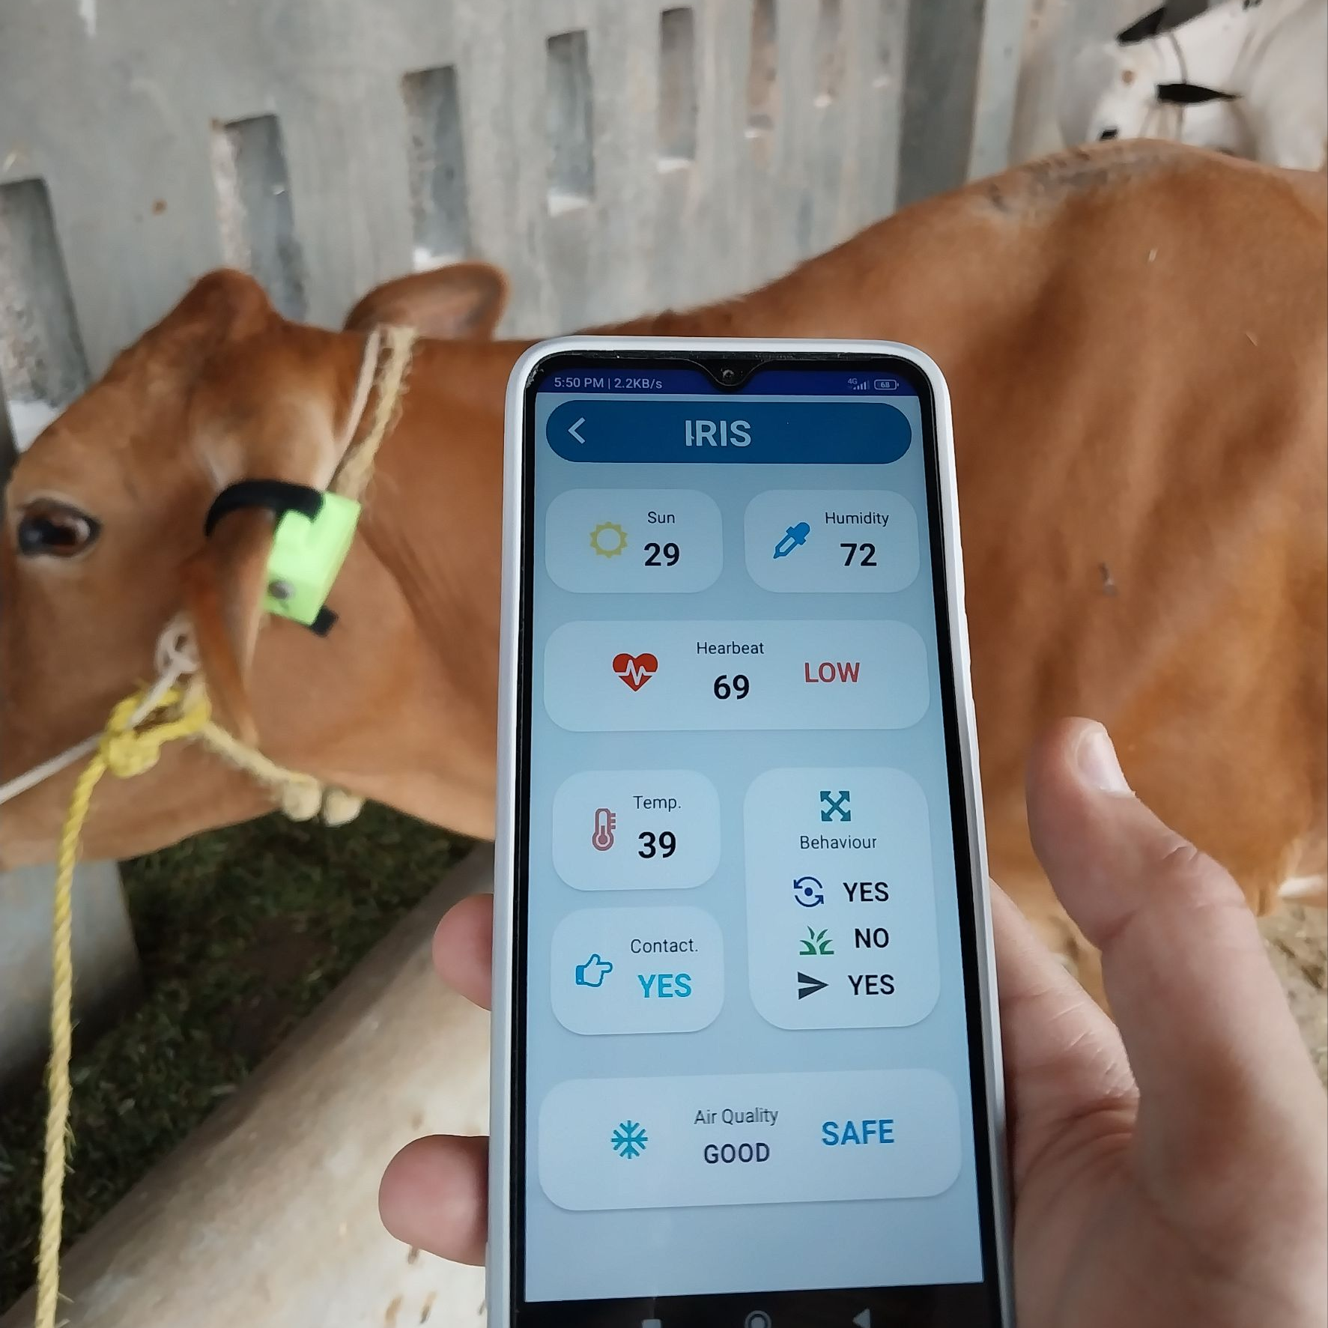
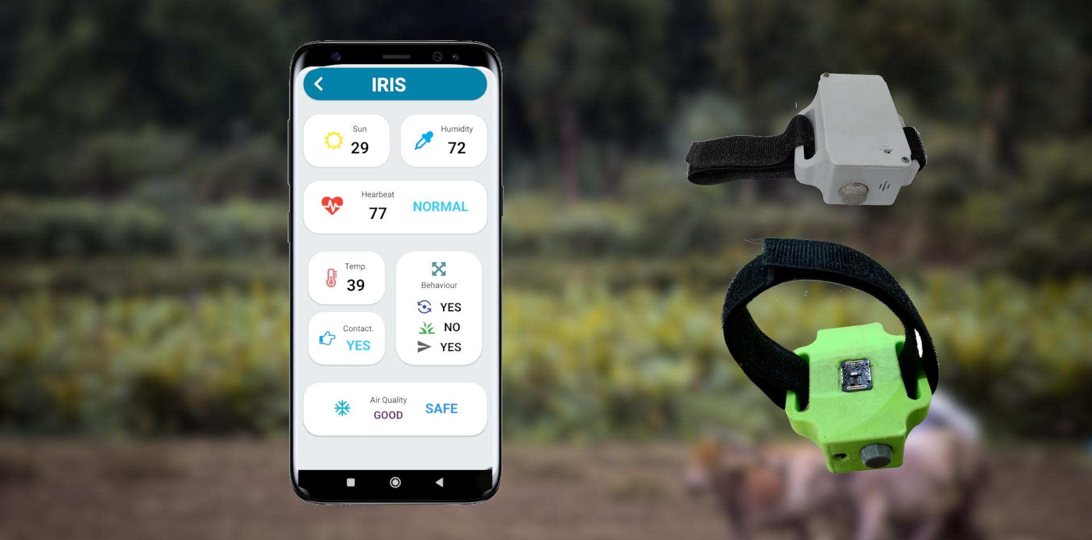
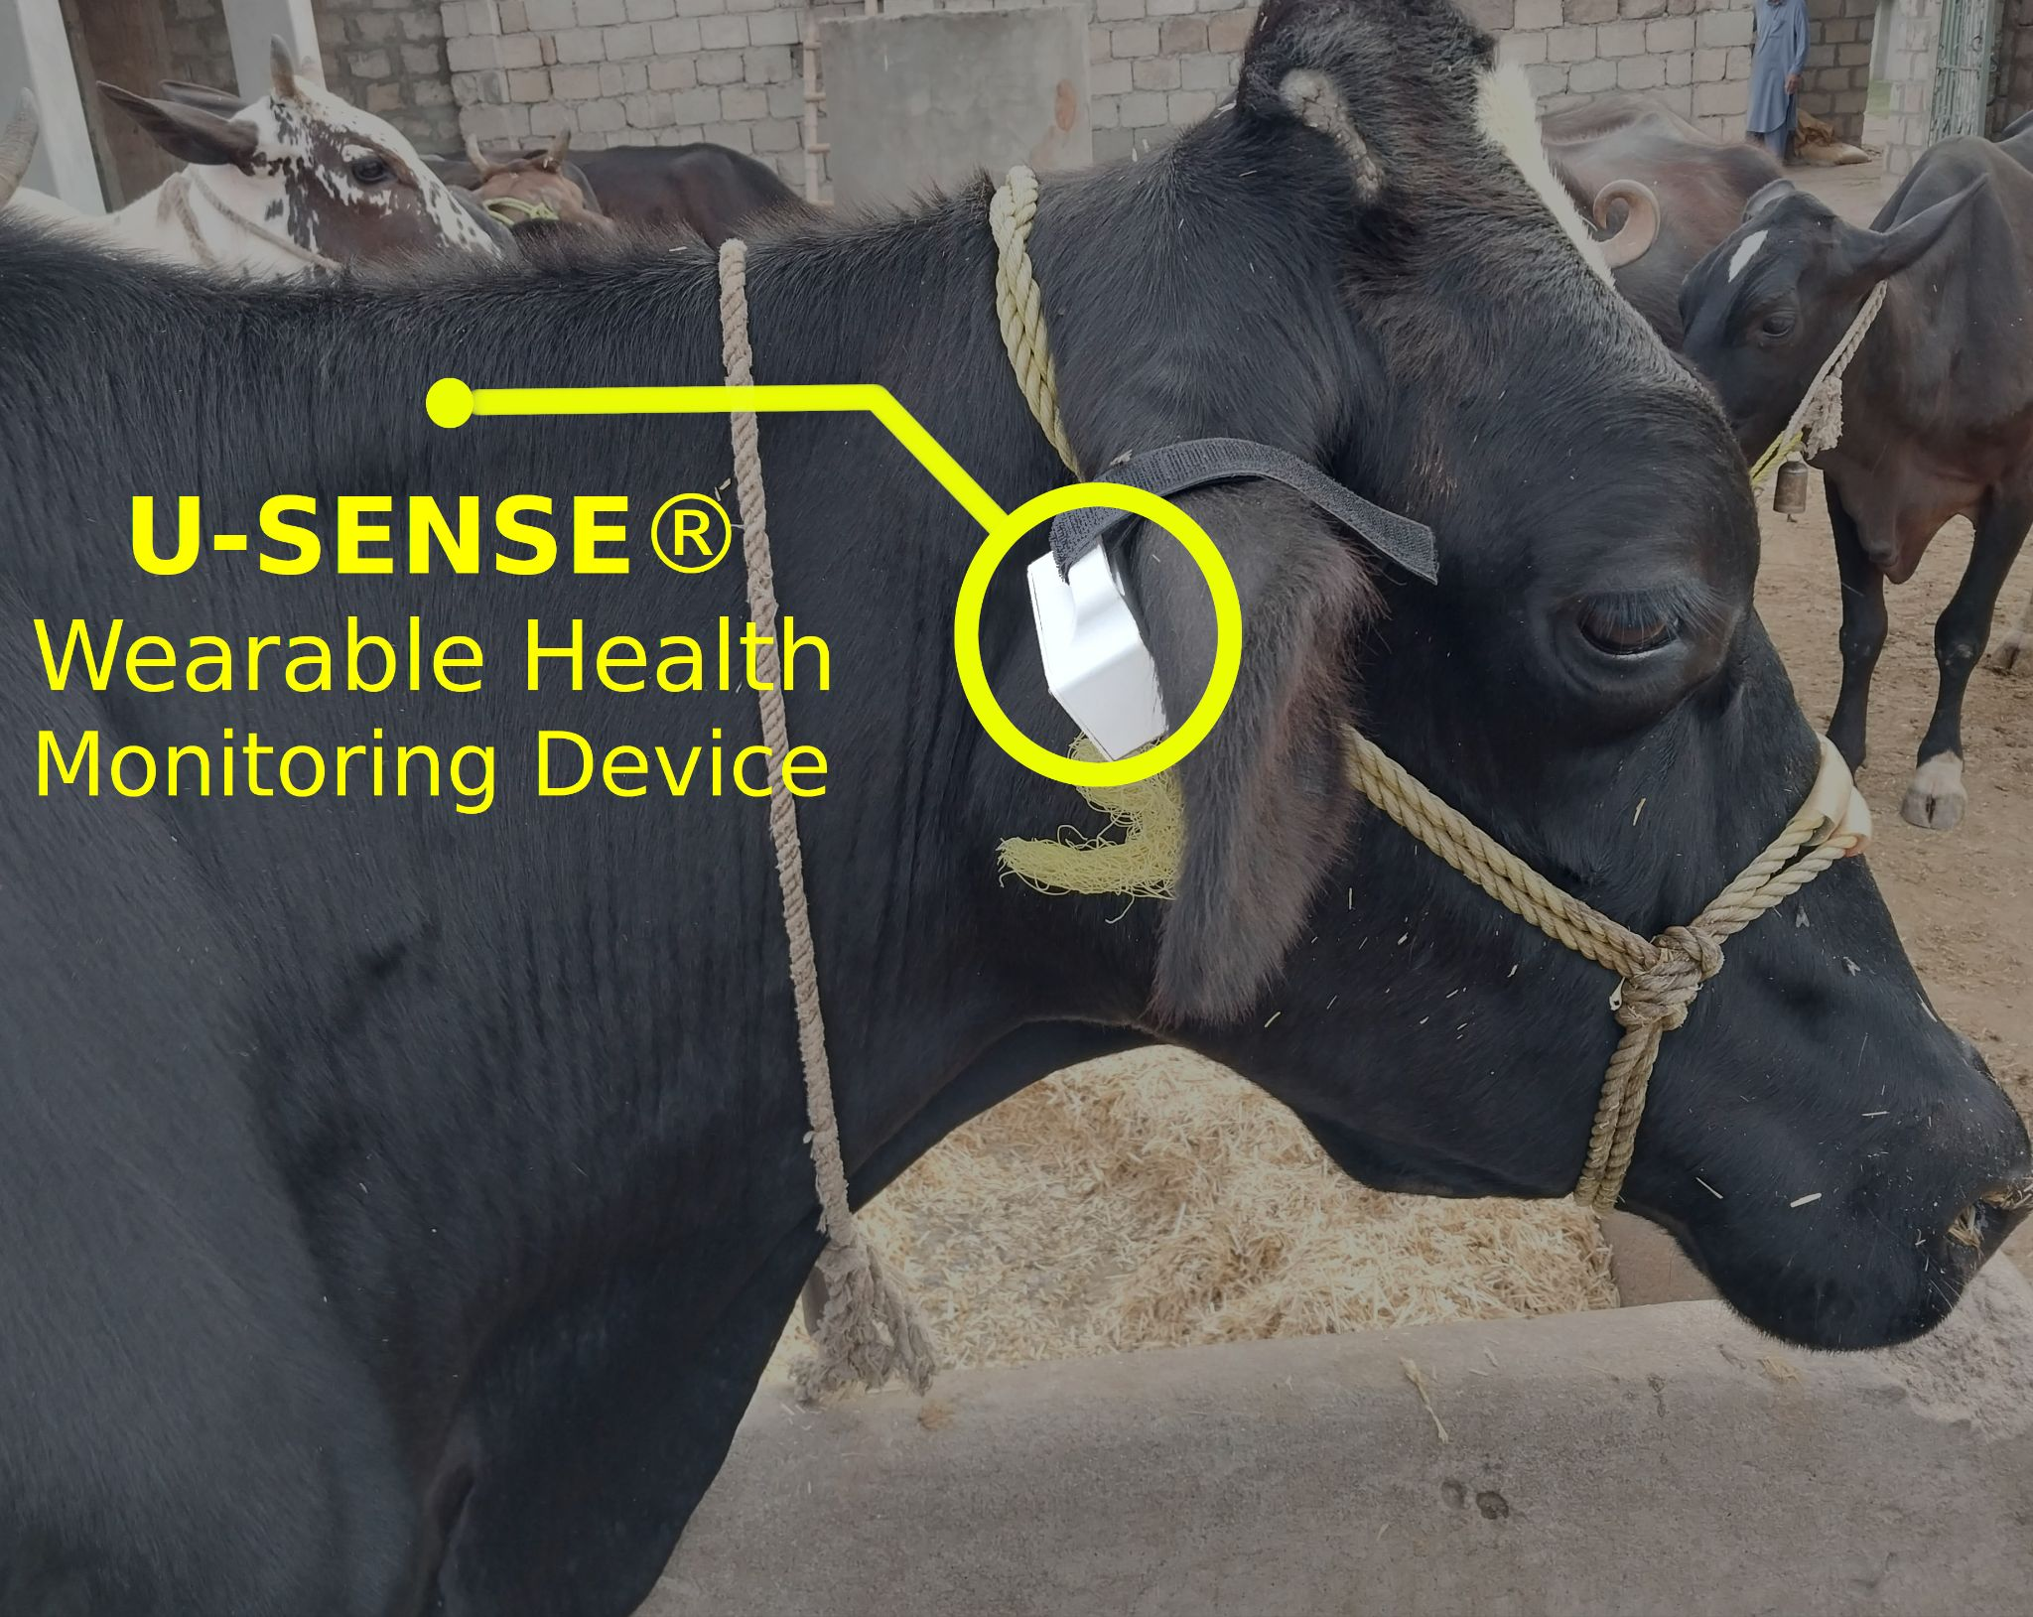






OPEN HOUSE
& JOB FAIR
2023
Cattle Health Monitoring System
Project Member
Project Supervisor
MUHAMMAD AITESAM
FA19-BEE-033
Dr. Muhammad Iqbal,
Associate Professor,
Dept of Electrical and Computer Engineering,
CUI Wah Campus.
Abstract
Cattle health monitoring system is an advanced wireless sensor system developed to improve health monitoring practices for the livestock industry. Based on IoT technology, it can monitor the biological data and behavioral activities of cattle and displays stats on the mobile application in a meaningful manner. These statistics can be further processed to make decisions about the health of the cattle. Thus, making the farm management easier for the farmers.
Design
Results
The system consists of wearable
hardware device and a mobile
application. The hardware installed on cattle body monitors the health stats which is transmitted to cloud server. The mobile app features a user interface to display the data in an informative manner.
The system collects and transmits sensor data including heart rate, body temperature, walking and grazing patterns along with environmental conditions including temperature, humidity and presence of toxic gases. The data is processed further to determine if an animal is healthy or not.
Development Tools
COMSATS UNIVERSITY ISLAMABAD, WAH CAMPUS

